Slide 1





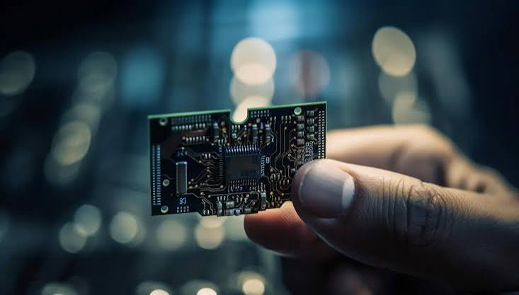

1
FPGA BASED
INTELLIGENT UART
COMMAND & CONTROL SYSTEM
USING VERILOG
A Real-Time Two-Way Communication System for Smart Control Applications
Presented by:
Sameeksha H
Shreya
Department:
Electronics Engineering (VLSI Design & Technology)
College:
NMAM Institute of Technology,
Nitte

Slide 2
2
PROJECT OVERVIEW
PROBLEM STATEMENT
Existing UART communication systems often rely on software processing, which increases latency and reduces real-time performance. A hardware-based solution is needed to receive, process, validate, and respond to UART commands quickly and reliably. This project implements an FPGA-based UART command processing and response generation system using Verilog to achieve fast, deterministic, and real-time communication.
OBJECTIVE
• Receive UART commands from a PC.
• Decode commands using Verilog.
• Execute the requested operation.
• Generate acknowledgment.
• Enable real-time communication.
KEY FEATURES
✔ Real-time UART Communication
✔ Two-way Data Transfer
✔ Hardware-based Processing
✔ Low Latency
✔ Reliable Operation
✔ Modular Verilog Design
EXPECTED OUTCOME
A real-time FPGA system capable of receiving,
processing and responding to UART commands
efficiently with high reliability

Slide 3
3
SYSTEM WORKFLOW
PC / Python Terminal
Sends UART commands to the FPGA.
USB-to-UART Interface
Converts USB data into UART serial communication.
UART Receiver (RX)
Receives serial data from the PC.
Command Decoder
Decodes and identifies the received command.
Command Processing Unit (Verilog)
Processes the command and performs the required operation.
LED / Output Control
Controls LEDs or other output devices based on the command.
UART Transmitter (TX)
Transmits the processed response back to the PC.
ACK / Response to PC
Sends an acknowledgment or response indicating successful command execution.

Slide 4
4
PROJECT IMPLEMENTATION
HARDWARE USED SOFTWARE USED
• FPGA Board • Verilog HDL
• USB-UART • Vivado
• PC • Serial Terminal
• LED • UART Protocol
MODULES IMPLEMENTED
• UART RX
• Command Decoder
• Control Logic
• UART TX
• LED Controller

Slide 5
5
RESULT AND DEMONSTRATION
DEMONSTRATION RESULTS
✔ UART communication established
✔ Commands processed successfully
✔ LED controlled in real time
✔ ACK response received
✔ Stable and reliable operation

Slide 6

6
APPLICATIONS
• Industrial Automation
• Robotics
• Smart Home Systems
• IoT Devices
• Remote Hardware Control
FUTURE SCOPE
✔ Support Multiple Hardware Devices
✔ Develop a GUI for Easy Control
✔ Add Bluetooth / Wi-Fi / Ethernet
✔ Implement Secure UART Communication
✔ Support Advanced Command Processing
✔ Integrate with Industrial & IoT Systems
THANK YOU

